Slide 1
IBM Edge Computing for Devices
Technical Demos
Dave Booz
booz@us.ibm.com

Slide 2
Topics
What is edge computing?
What are the edges?
What is the IBM Edge Computing offering?
What scenarios are addressed by the IBM Edge Computing offering?
What problems does it solve?
Why is it valuable? What are its key features?
How does it work?
How does it ensure the security of the system?
How does it handle multi-tenancy?

Slide 3
Edge Computing…
places enterprise applications
closer to where the data is created, and where actions need to be taken
Notes:
"Edge computing is the practice of processing data near the edge of your network, where the data is being generated, instead of centrally at the datacenter”
Image credit University of Washington

Slide 4
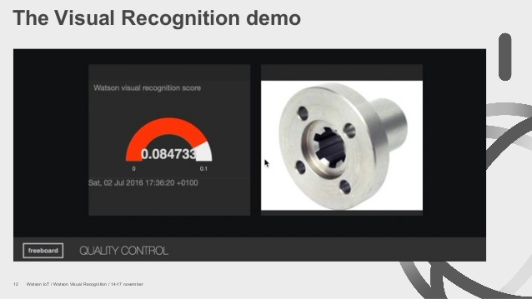
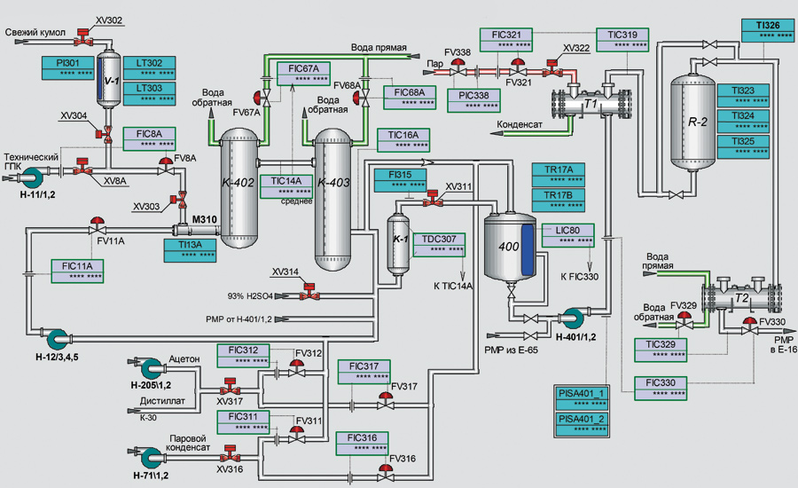
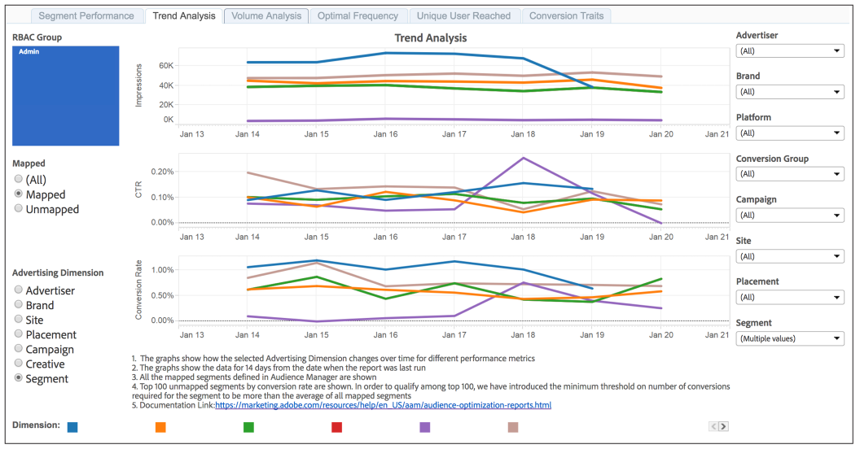
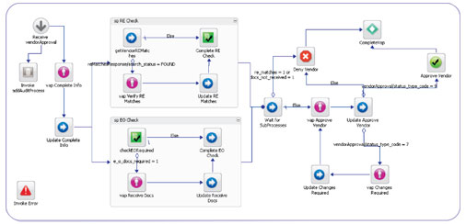

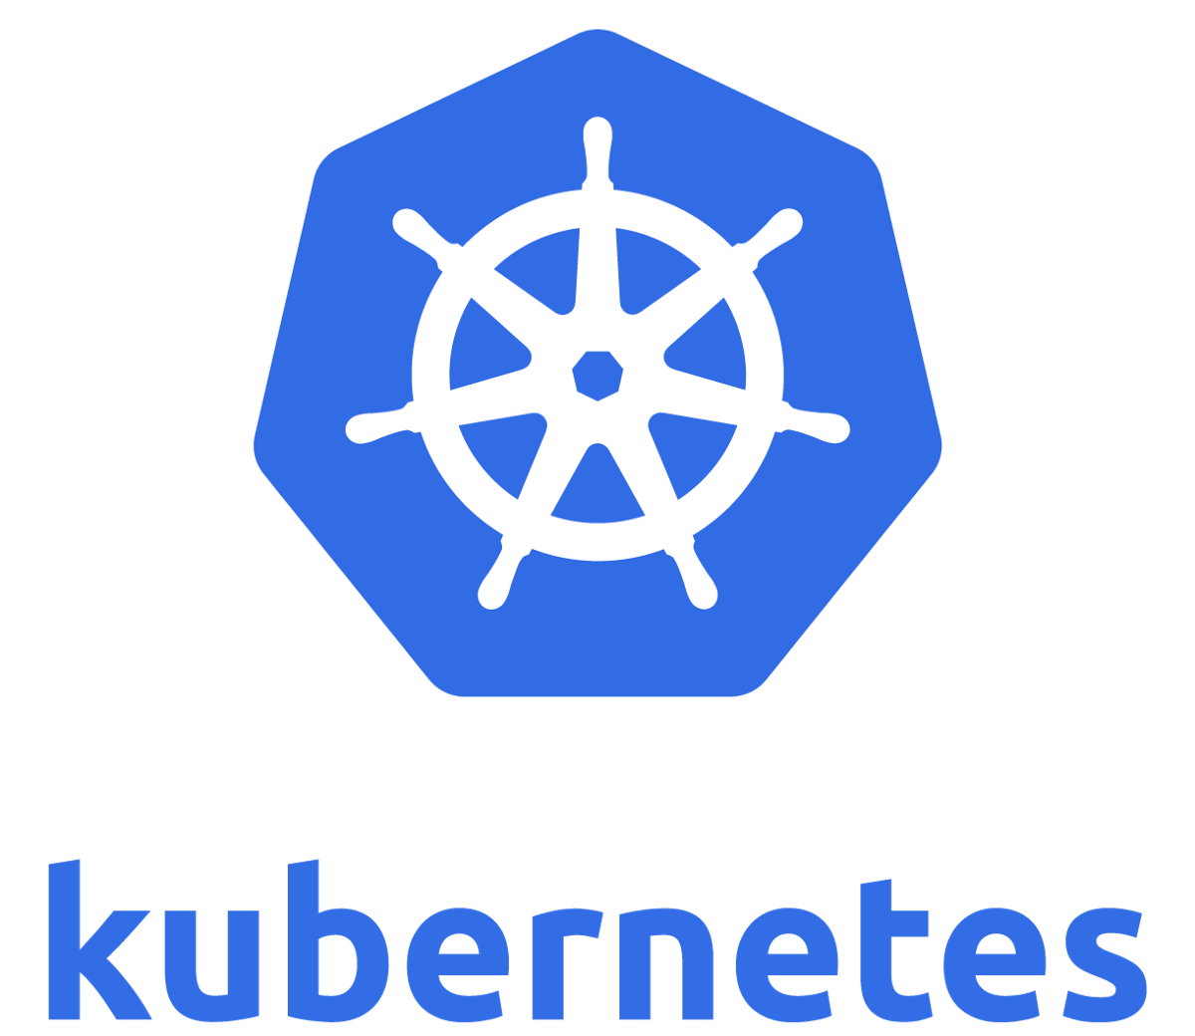

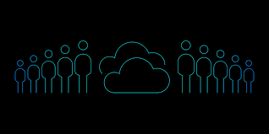
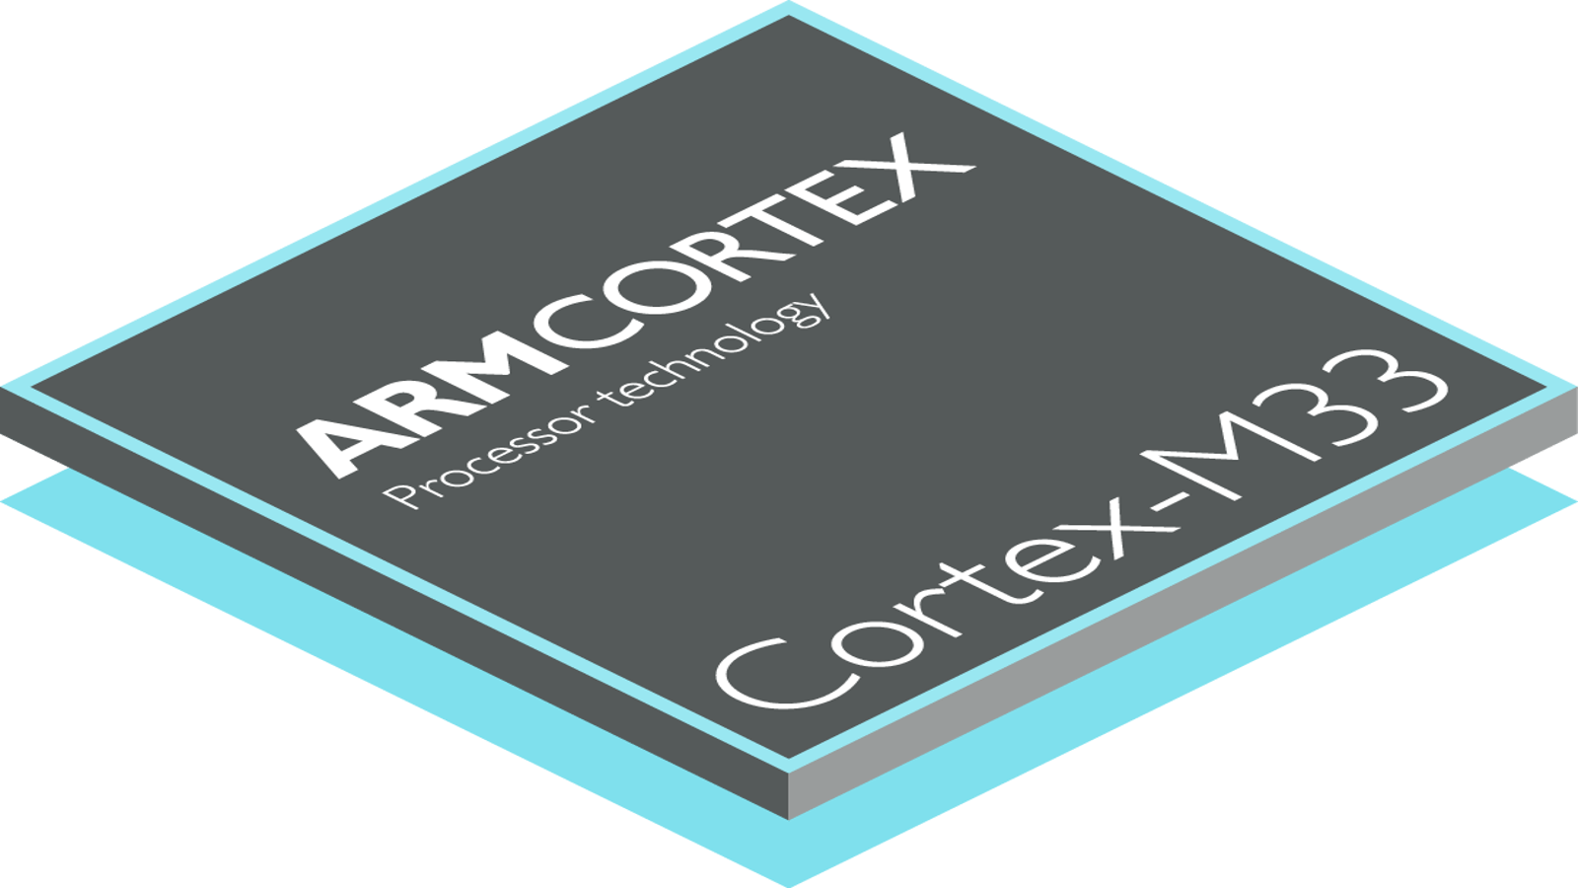
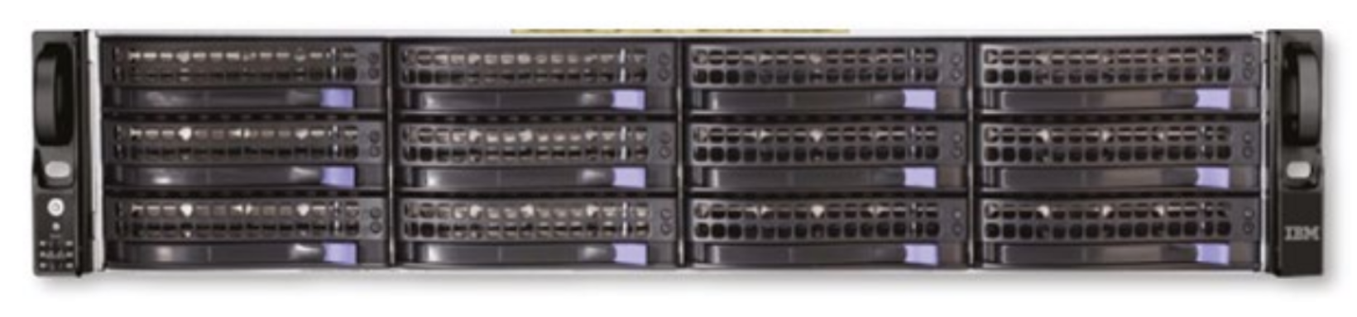
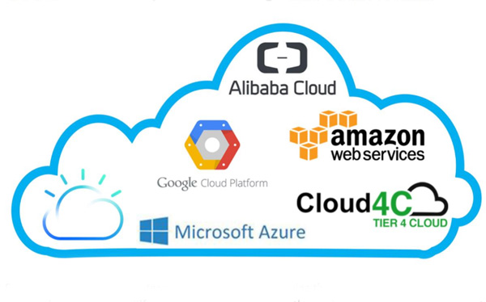
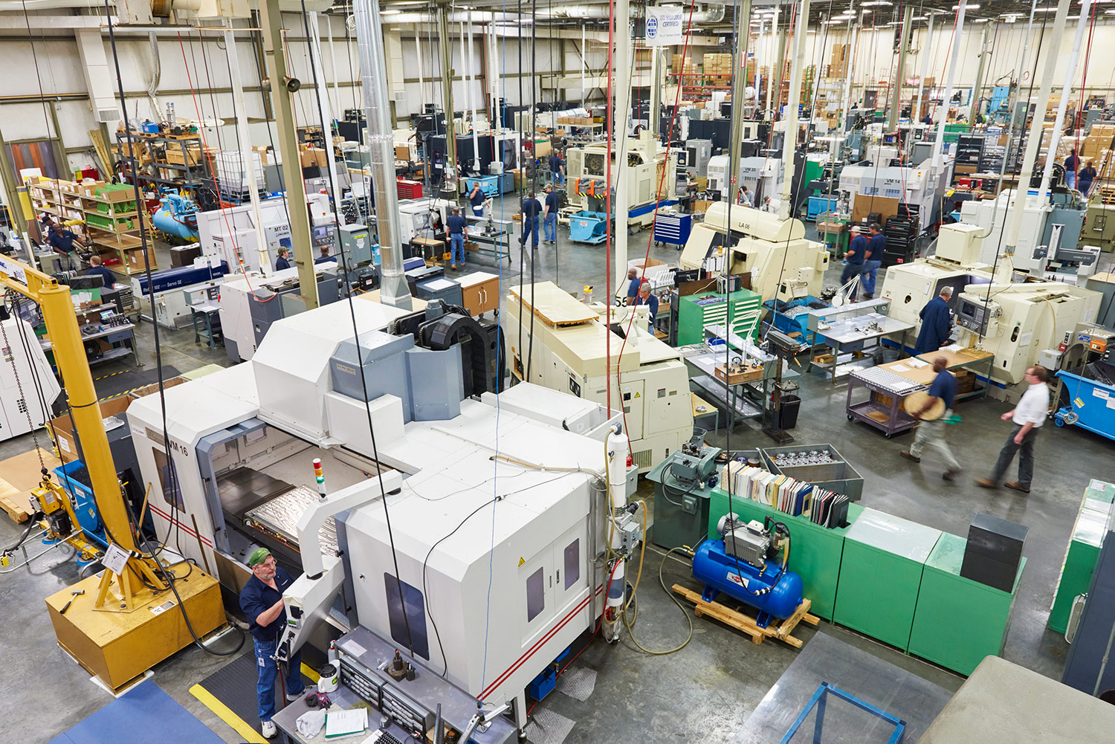
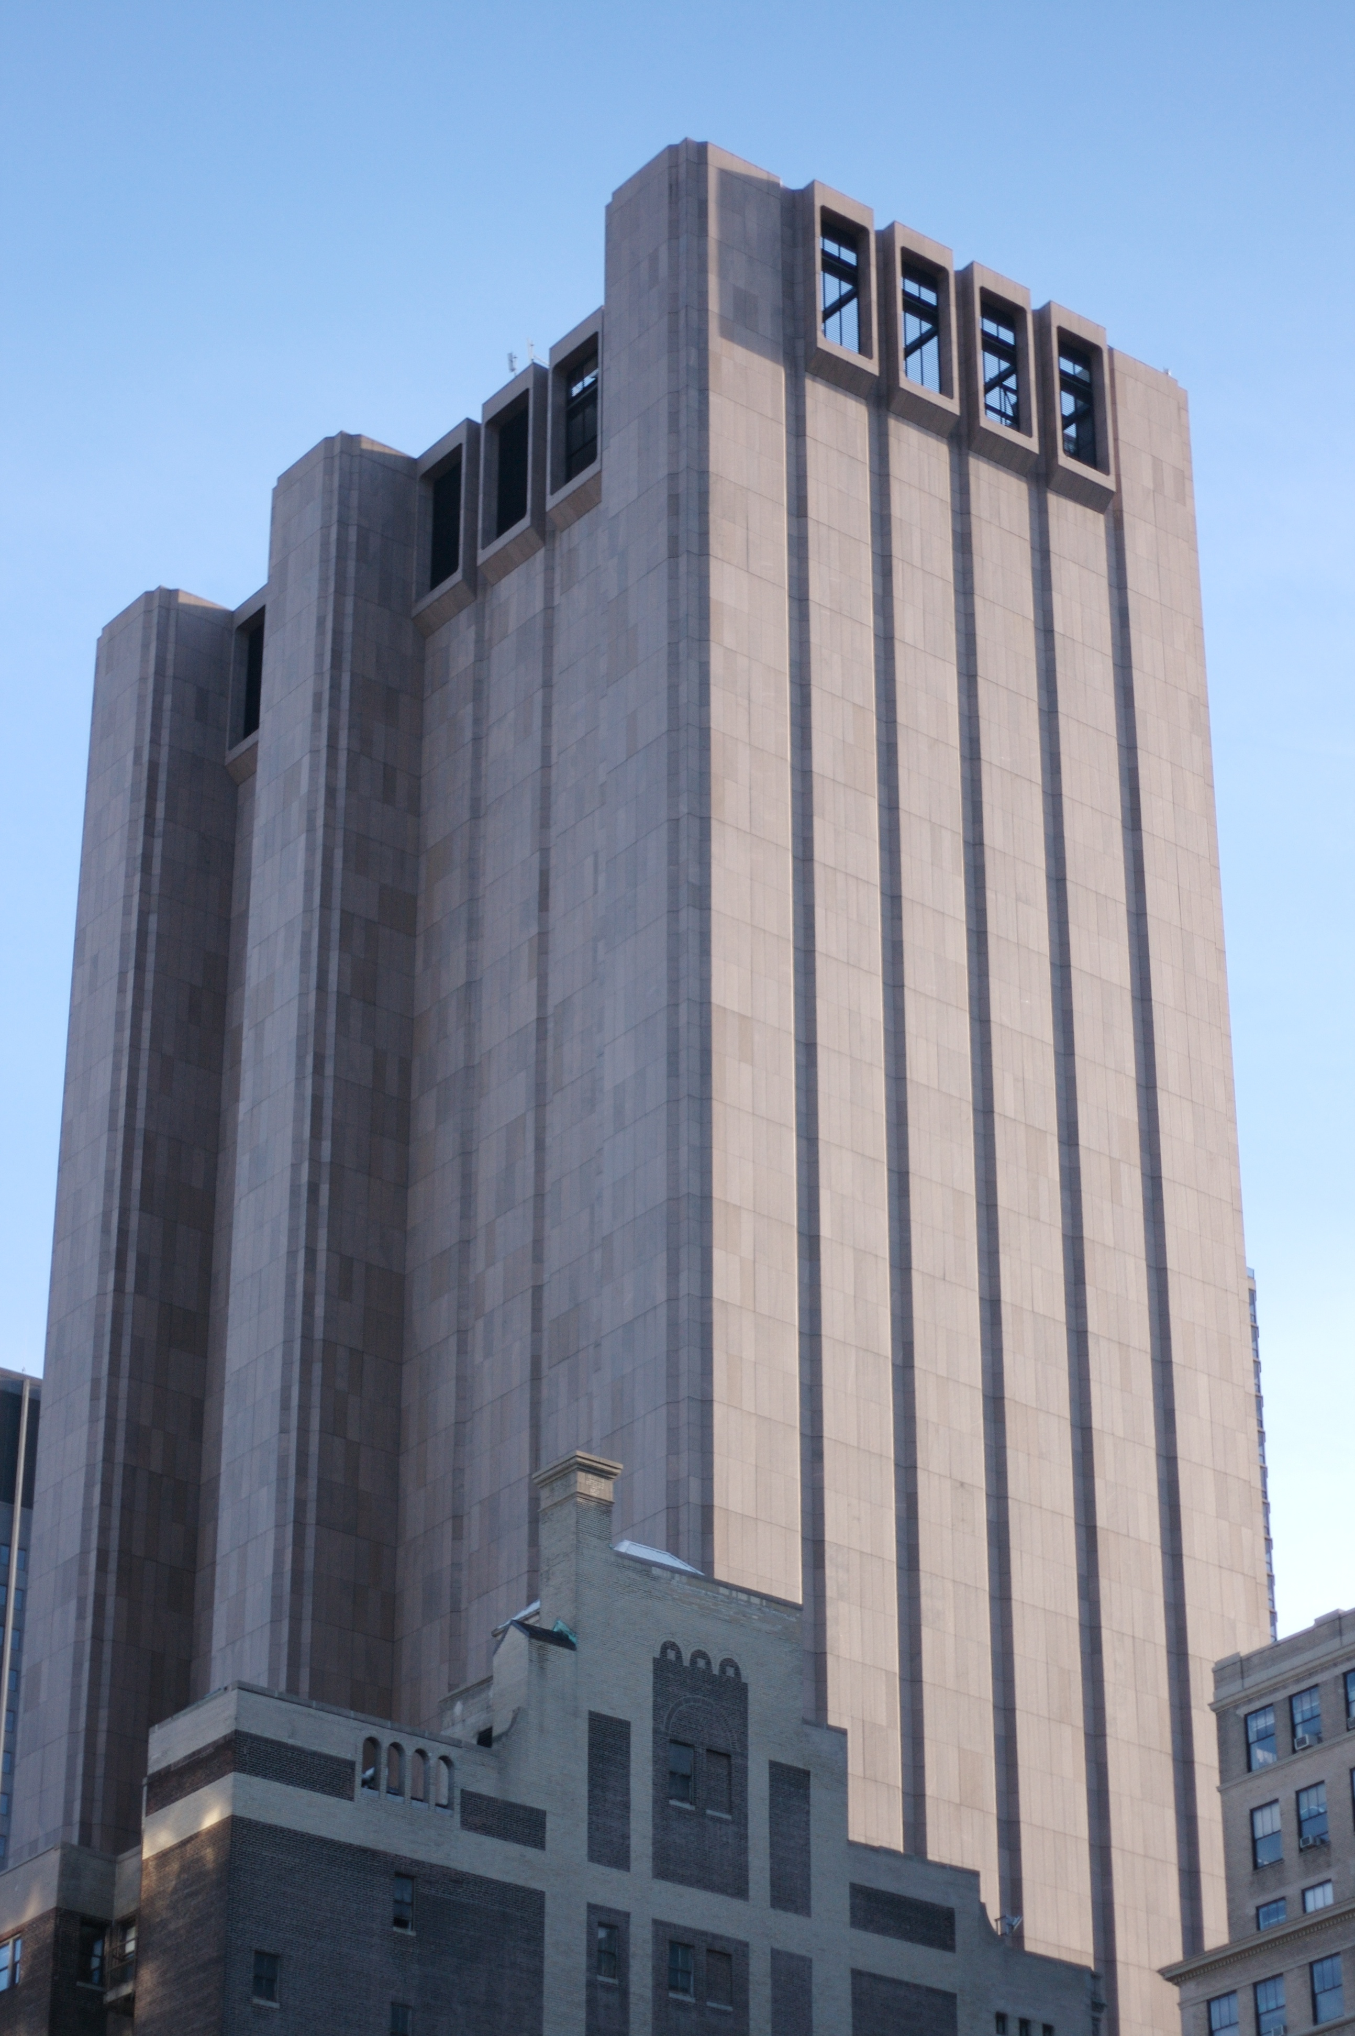
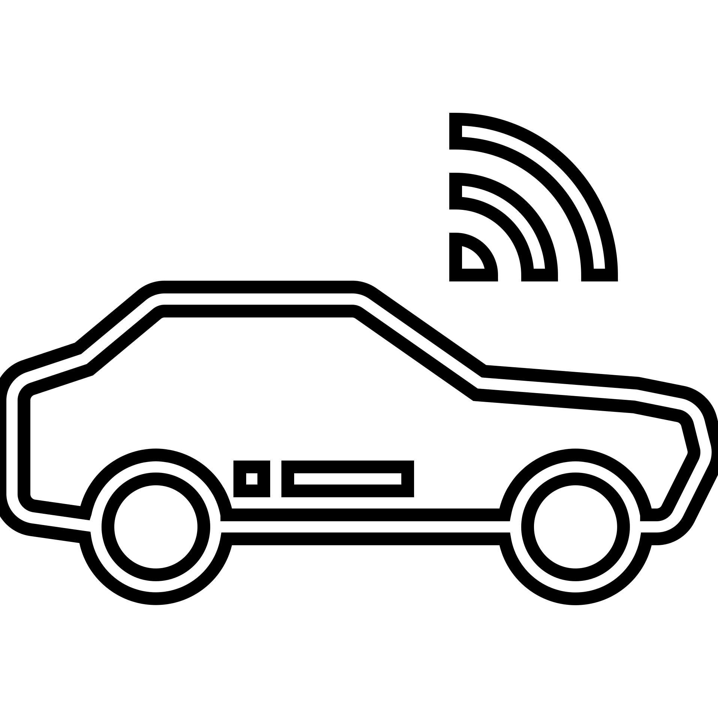
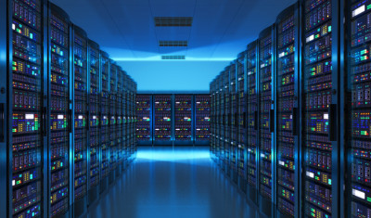


What are the edges?
This is the Edge (Edge Nodes)
Edge Devices
Edge Server/Gateway
Edge Network
Hybrid Cloud Computing
Management Hub
Public Cloud
IT Data Center

Slide 5
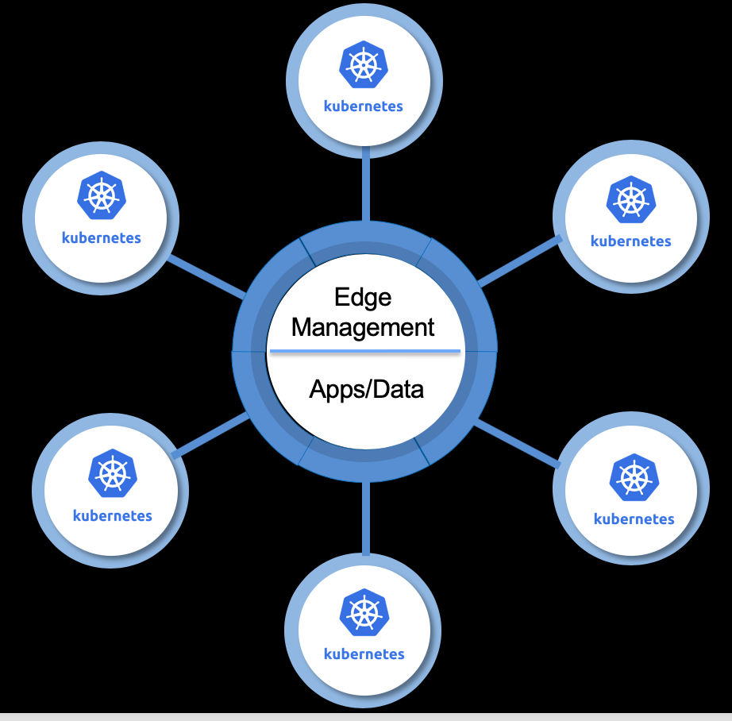
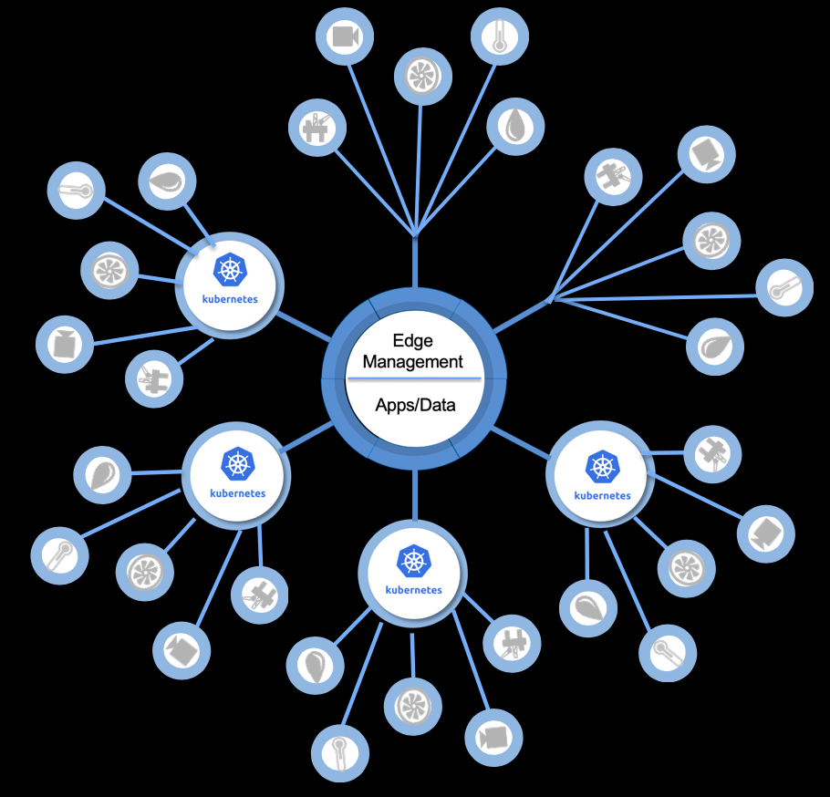
What is the IBM Edge Computing offering?
IBM Edge for Edge Servers
IBM Edge for Edge Devices
Schedule, manage, distribute workloads outside walls of traditional data centers at remote, sometimes disconnected, locations
Managed by central IBM Edge ‘hub’
Edge Server is Kubernetes based container platform
Typically 1GB+ hardware
Scale from 10s-100s of servers
Examples: cruise ships, regional distribution centers, warehouses, retail stores
Enabled on x86, Power
Manage and distribute workloads outside walls of traditional data centers at satellite locations and on devices
Managed by central IBM Edge ‘hub’
Edge devices can communicate back to an Edge Server or directly
Typically less than 1GB hardware
Scale to 1,000s of devices
Applications/intelligent compute at the device
Examples of Edge devices:
Kiosks, video cameras, drones, manufacturing equipment, etc.

Slide 6
Scenarios

Slide 7
3,000 pieces of equipment on the factory floor
Presses
Assembly machines
Paint Robots
Conveyers
An outage in a production run costs you $250,000 / hr
Operating at peak efficiency and with no un-planned outages is the difference between profit and no profit
Imagine …
You are a Manufacturer
of electric bicycles
You want …
Analytic algorithms that monitor how well each piece of equipment is running, and adjusts the operating parameters to improve its efficiency
Analytic algorithms that detect and predict when a failure is likely to occur so that you can schedule maintenance on it between runs

Slide 8
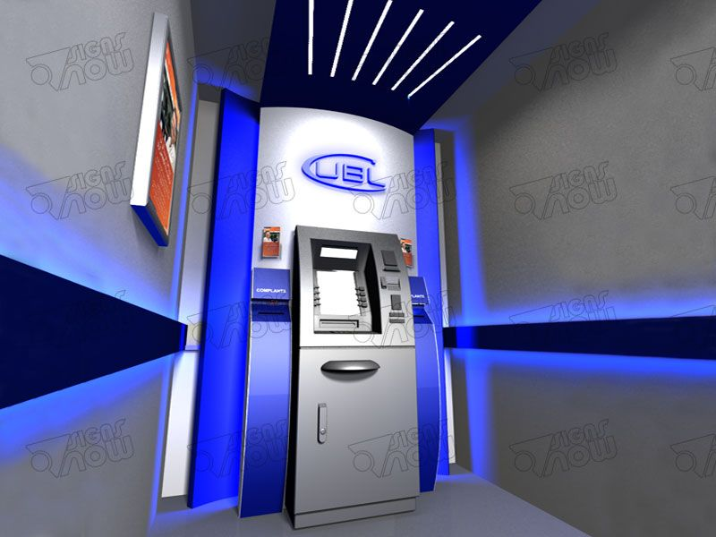
You need to quickly identify threats
Customers that may be at risk of an attack
ATMs that may be at risk of break-ins or vandalism
You have hundreds of ATM vestibules located across many cities.
Each is monitored by camera, but that’s very resource intensive, and sometimes attacks occur before you can activate a Police response.
Imagine …
You are the security department at a Bank
with responsibility for protecting the equipment and customers in your ATM vestibules
You want …
Video analytics that will automatically recognize individuals of interest, behaviors, and weapons that might indicate the risk of an attack before it actually commences.
Alerts to your limited security team for those specific occasions where those threats exist so they can activate a quick response.

Slide 9
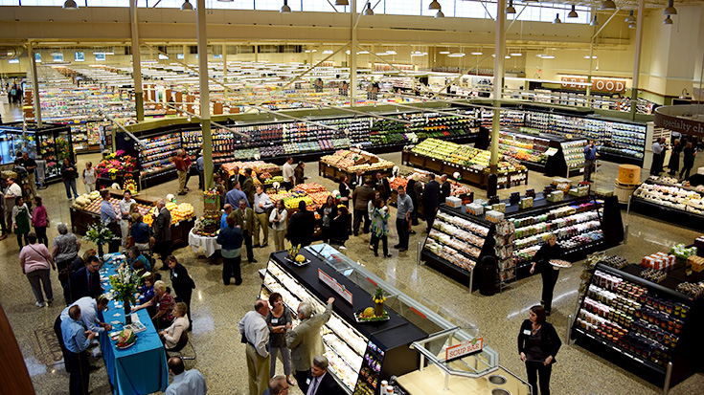
You leverage an array of devices to manage your store
POS Terminals
Self—service checkouts
Stationary and Robot-mounted Video Cameras
Inventory trackers
You have to manage inventory stocking, deal with spoilage and spillage, increase customer traffic, improve the shopping experience, all while protecting patrons from injury and inventory from theft.
Imagine …
You manage a Regional Retail Chain
that sells groceries in mid-size neighborhood strip malls
You want …
Video analytics that will automatically recognize stock levels on the shelves, spillage, congestion, and theft.
POS terminals that will lower the checkout time and simplify self-checkout.
Robots that will safely inventory stock, and facilitate re-stocking.

Slide 10
140 Hotel Properties with and average of:
250 rooms per property
2 nights per stay
65% occupancy
4.1 Million unique experiences
You have installed a virtual assistant in every room
An alarm clock-sized device that your guests can speak to
Imagine …
You run a National Hotel Chain
that differentiates on personalized and convenient service for business travelers
You want to use conversational services that your guests can use to:
Control the room and entertainment
Plan their schedule
Find out about local events and services
Make reservations
Customize uniquely during their stay

Slide 11
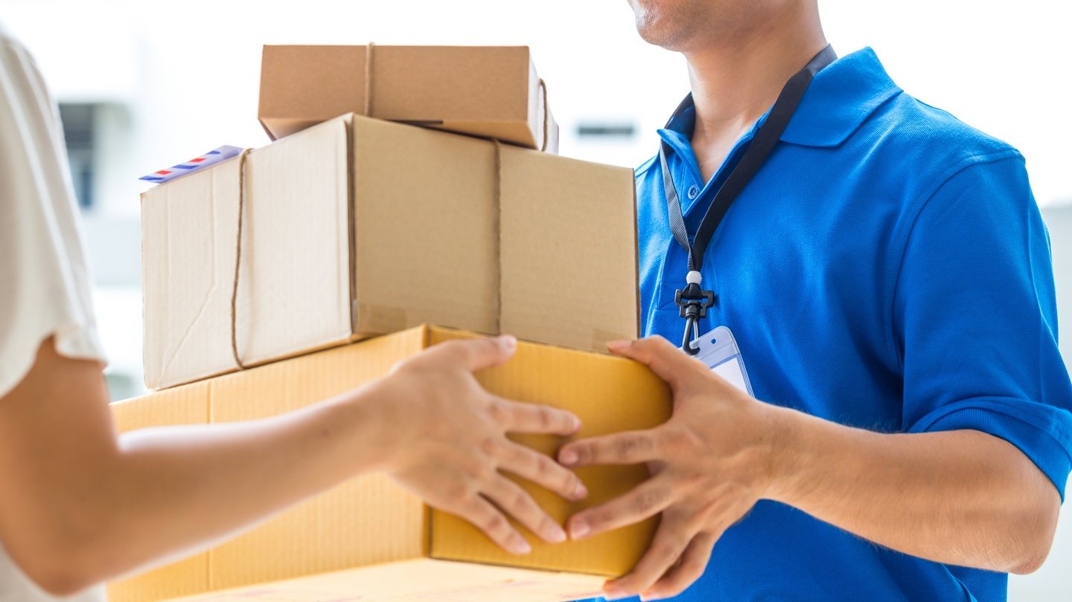
Optimizing the delivery route for each vehicle can:
lower time, labor, and fuel costs
reduce carbon emissions
decrease traffic accidents and congestion
improve work conditions
Every delivery vehicle has GPS, weather sensors, the delivery roster, the driver’s work and personal schedule, and other biometric and work environment input from on-board and wearable sensors
Imagine …
You are an international Logistics company
with responsibility for your package delivery division
You want to use real-time route-planning algorithms that factor in:
The overall delivery roster
Changing traffic and weather conditions
The driver’s business and personal work schedule (e.g. Doctor’s Appointments)
Environmental and health conditions (e.g. temperature exposure, respiratory patterns, rest breaks, etc.)
And collect local meteorological data to feed back to improve fine-grained weather prediction models

Slide 12
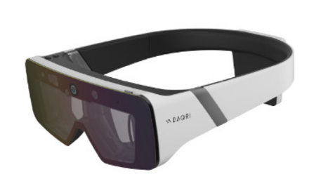
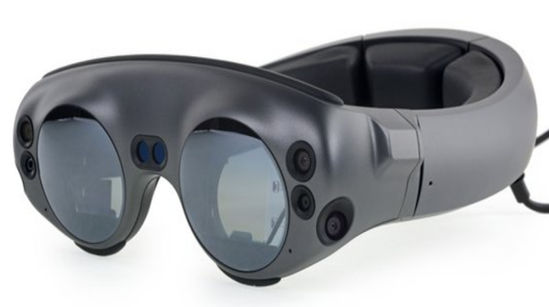
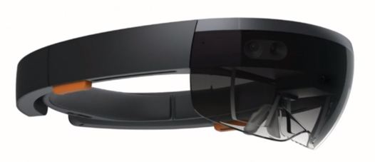



Offloading compute / activity to 5G network edge can:
Improve battery life of AR/VR device
Reduce form factor
Improve power of applications and features
Improve compute and features with dynamic updates
Augmented and Virtual Reality headsets require very low latency between movement and visual field – or risk user nausea or experience dissatisfaction.
Imagine …
You connect augmented reality & VR headsets and must offload compute to the 5G Network Edge
You want to leverage sub 10ms latency to 5G base stations to :
Image rendering
Host applications (e.g. virtualized gaming engine)
Deliver AI features (speech and image recognition; assistants)
AR and VR headsets can be computationally lightweight, therefore physically light and small on the head.

Slide 13




Edge Computing Exposes New Challenges
1
15 Billion devices today; by 2022 device growth is expected to reach 55 Billion
Scale
2
Device Variance
Billions of devices leads to heterogeneity in device type, size, protocols etc.
3
Unmanaged
Data
Countless devices leads to significant data that needs to be controlled automatically
4
Edge devices drive demand for solutions that drive intelligent responses to data
Actionable Data
Notes:
Spend on edge computing by 2022 is expected to be $6.7B: https://www.prnewswire.com/news-releases/edge-computing-market-worth-672-billion-usd-by-2022-654465673.html

Slide 14
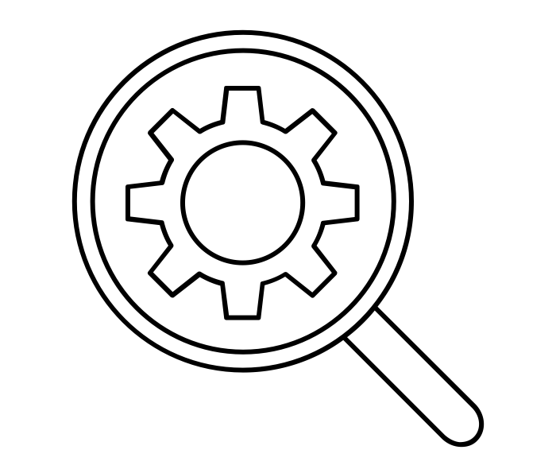

4 Key Tenets of IBM Edge Computing
1
Management at enormous scale
2
3
4
Open source technologies
Data Protection
Value add capabilities
Management of edge workloads at massive scale with visibility, control, and automation
Common management and orchestration across clusters and edge
Policy-based role and compliance management
Event & service management
Open technology with portability across private, public, and edge
Open Kubernetes/container technology for app delivery
Open source middleware for data, messaging, and caching services
OpenPOWER, x86 and ARM hardware
Built on Open Horizon project
Security and compliance with a focus on data protection
A focus on policy & privacy for regulated industries
Signed workloads with runtime isolation and data encryption
Compliance supported with reporting and auditing
Specialized platform-services to drive innovation
Rich catalog of services such as Watson AI, IVA, IoT, etc.
Function specific infrastructure access (GPU, FPGA, etc.)
Machine / Deep Learning in the cloud and at the edge
Thousands of gateways/servers and billions of devices.
Enterprise grade. Open by design.
Notes:
IVA – IBM Video Analytics
GPU – Graphics Processing Unit
FPGA – Field Programmable Gate Array

Slide 15
Why is it valuable? What are its key features?
Increases the utility of edge devices and servers
Enabling improvements in
business efficiency,
reduced network costs,
operating resiliency, and
customer and employee engagement
While avoiding additional administrative staff
Ensures the integrity of business operations
Responds automatically to dynamic changes in operating purpose, location, exposure, priorities
Built on Open Source (https://github.com/open-horizon) to maximize the utility of the ecosystem
Automated deployment of containerized workloads to 1,000s of edge devices
Controlled through deployment policies and constraints
Without human intervention
Agreements negotiated between device and exchange
Continuous monitoring
Automated shutdown of work and re-negotiation of agreements in the event of a change in policy conditions
Secured and tamper-resistant
Multi-tenancy and workload isolation at the device
Very small footprint (~30MB of memory footprint)
Support for ARM and x86 CPUs and Linux OS
Enabling virtually any containerized workloads – AI, Analytics, Procedural, micro-services

Slide 16
How does it work? Specific to IBM Edge for Devices
Key Concepts
Workloads are micro-services packaged as Containers – either individual or a grouped collection
Workload is placed on individual nodes as the result of an Agreement that is negotiated between the device Agent and an Agreement-Bot (AgBot)
Negotiations are predicated on a set of expressed conditions: either a Pattern or a Policy
The Agent and the AgBot actively monitor that the negotiated agreements remains valid in the presence of changing conditions

Slide 17
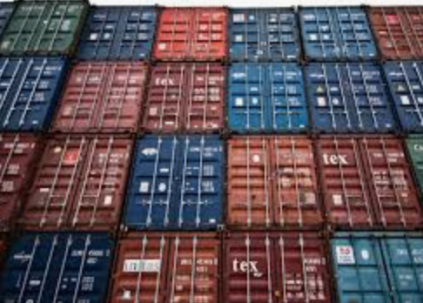
The Main Edge Fabric Components
On-Premises (Gateways+Devices)
Data Center / On-Premises Operations Locations
Devices
Edge Fabric
Edge Workload Management
Edge Fabric Exchange
Container workloads
IBM Cloud Private
Cloud Infrastructure
Potentially
> 1,000,000s
System State
Exchange
Switchboard
Edge Node Registration
Service Publication
Status Queries
P2P Messaging Service
Encrypted
Incapable of Eavesdropping
Agent
Register Node
Negotiate Agreements
Model Synchronization
Monitor Agreement Conditions
Model Repository
Model Manager
Agreement Bot (AgBot)
Model Synchronization
Negotiate Agreements
Policy-based Placement
Set agreement status
Can be distributed elsewhere and replaceable

Slide 18
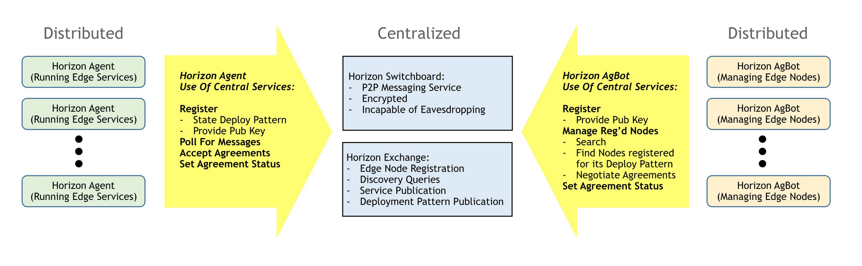
Agreement processing
When the node was registered (with the “hzn register” command) it kicked off a negotiation between the Horizon Agent (aka Anax) running on the device, and the Horizon AgBot running elsewhere (in the Cloud in this case)
That negotiation is intended to determine what workloads (collection of Docker containers) to run on that device
The result of that negotiation is an Agreement representing the contract formed by that negotiation to run that workload there at that time
Any violation of the conditions and constraints considered in that negotiation will nullify the Agreement, and result in either a re-negotiation of of another agreement, or that workload being shut down
Forming an Agreement will result in downloading the workload containers from the Horizon Exchange, validating the security of the Containers (through a cert check), and starting the workloads
When the node was unregistered, the Agreement was cancelled and the workload was terminated

Slide 19
Placement Policies
Placement calculated from an optimization across declared (policy-defined)
node constraints
service (workload) requirements
network topology, and
organizational operating priorities
Analysis of optimal placement is evaluated on an on-going basis against current and changing conditions
“Properties and constraints” – any policy-set can express either types of properties that must be matched to satisfy the agreement
Address HA/CA requirements where needed for certain device scenarios
e.g.:
Future
Node Policies (Properties)
Compute, storage, network capacity
OS
Architecture
Geolocation / Geopolitical position / Environmental / Geo-fencing
Ownership
Content (Data)
Security / Vulnerability
Privacy
Co-processors
Availability
Form and Function
I/O Capabilities
User / system authentication and permissions
Service Policies (Properties)
Compute, storage, network requirement
OS
Architecture
Survivability (with network disconnects)
Content Dependence
Workload Dependence
Model / Artifact Dependence
Entitlement
Authorization
Form and Function Dependence
I/O Dependence
Topology Policies (Properties)
Inter-nodal latency
Protocols
Firewalls
Severability
Temporal dynamicity
Geolocation/ Geopolitical Constraints
Data Egress/Ingress
Organization / System / Solution Policies (Properties)
Business Priorities
Recovery
Regulations
Brand Integrity
SLAs
Contract / obligations
Upgrade policy
X
X
X

Slide 20
Placement Policies (cont)
Policies are comprised of:
Properties: Name-value pairs that assert ‘fact’s about the object (Node, Service, Topology, Business)
Constraints: Conditional expressions that must be satisfied by other parties in the negotiation
Properties
Names only have semantic value to the industry/business/application in which they’re used
Values can be any string, integer, boolean, float or list of strings
Built-in Properties
Are set automatically by the system, including:
openhorizon.cpu - The number of CPUs. The value is an integer type.
openhorizon.memory - The amount of memory in MBs. The value is an integer type.
openhorizon.arch - The Hardware architecture of the node (e.g. amd64, armv6, etc). The value is a string type.
openhorizon.service.url - The unique name of the service. The value is a string type.
openhorizon.service.org - The multi-tenant org where the service is defined. If service.url is specified but this property is omitted, the org defaults to the org of the node, service or policy which is referring to the service. The value is a string type.
openhorizon.service.version - The version of a service using the same semantic version syntax. The value is a version type.
Constraints
Supports:
For numeric and string types: ==, <, >, <=, >=
For string-lists: in
For Boolean types: AND (&&), OR (||) (and the True and False values)
Parenthetical evaluation precedence
Separation of responsibilities
Node policies are set by the node owner (or system administrator on behalf of the node owner)
Service policies are set by the service owner (typically the workload developer)
Topology policies are set by the network owner
Business policies are set by the business owner (or system administrator on behalf of the business)
All of which need to be coordinated around a shared ‘policy language’ (a common understanding the property semantics)

Slide 21
Patterns
Patterns simply assert which services to run on a given node
Can be thought of as a degenerate form of policy where the conclusion is pre-determined
Offers a simpler, but less scalable approach, for cases that are highly controlled (like, during service development and testing)
Any single node can be subject to either Patterns or Policy-based deployment, declared at the time of node registration

Slide 22
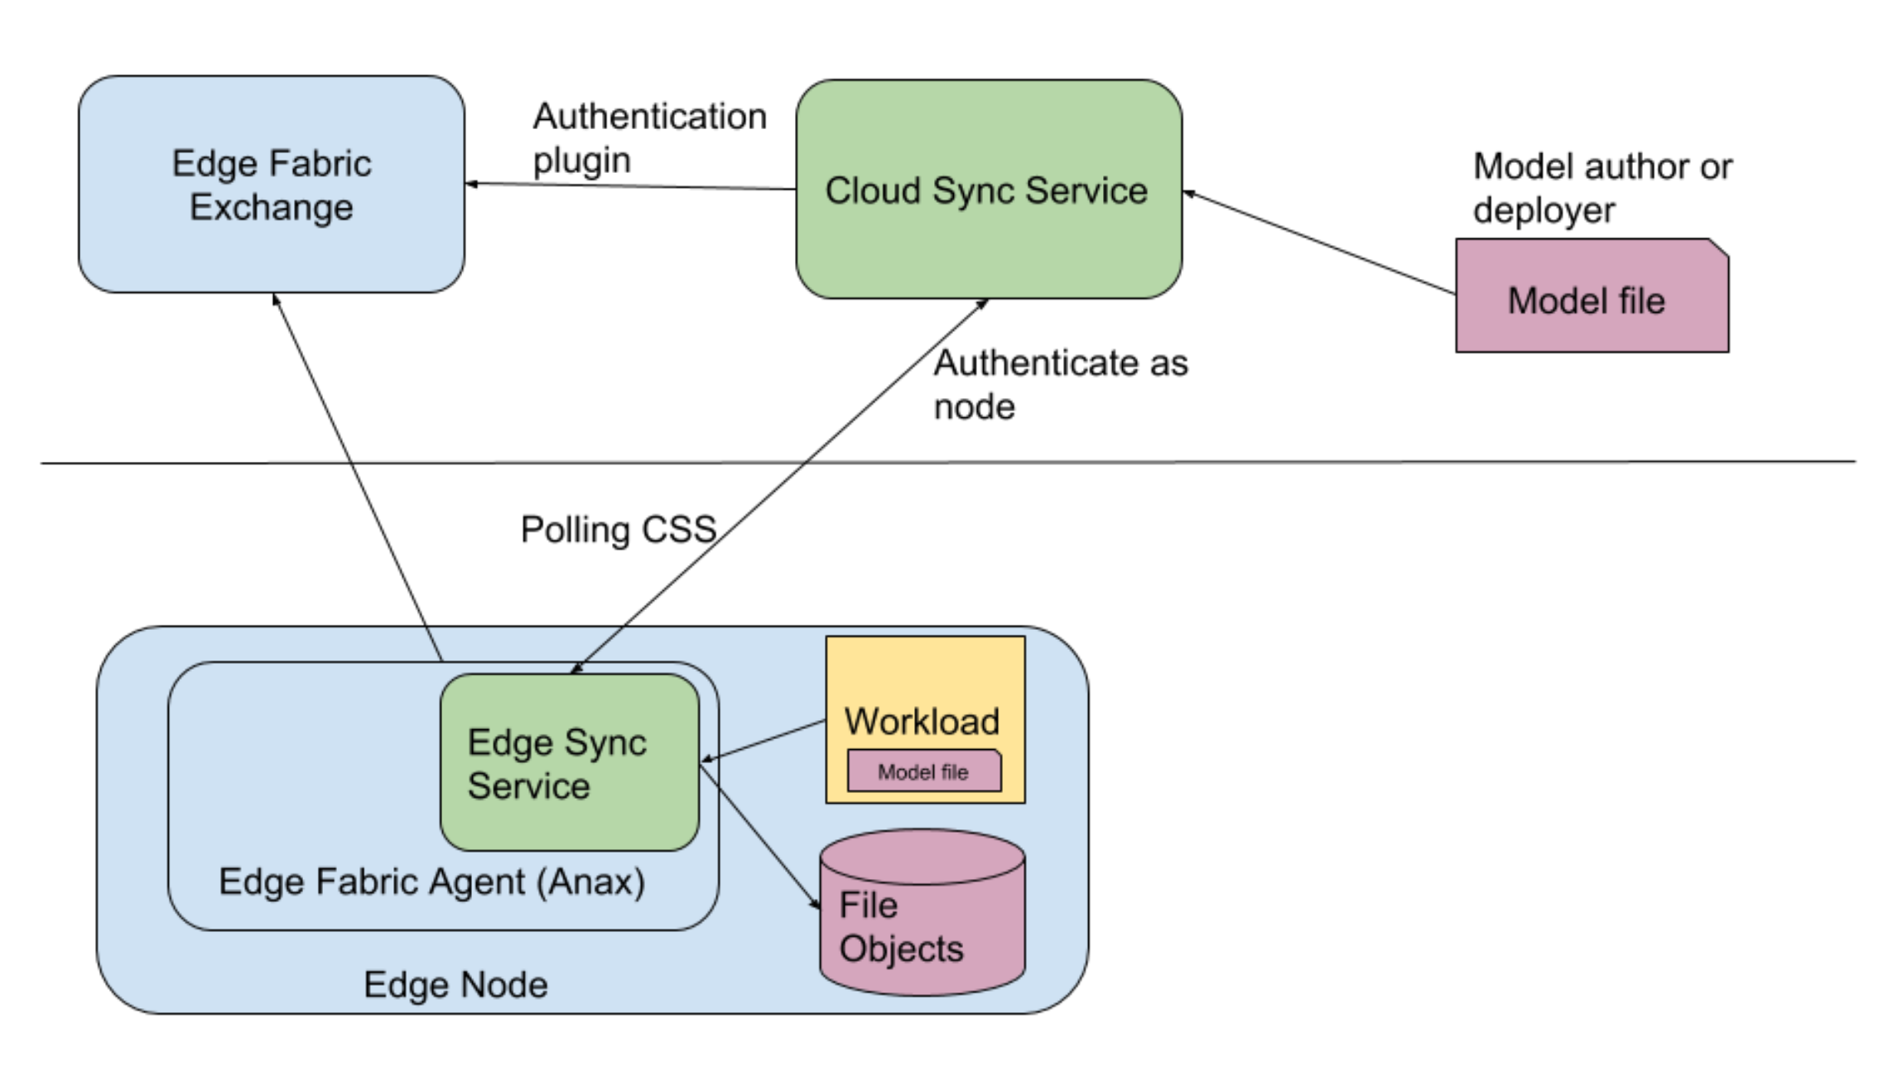
Model Management (via Sync Service)
Facilitate the storage, delivery and security of models and other metadata packages – separate from the core analytic logic
General assumption is that models are trained in the Cloud and distributed to the edge for inferencing
Predicated on the assertion that the Cloud or IT data center generally has more (elastic) compute resource available than individual edge nodes, as required by compute-intensive training requirements
Model / asset repository
Use your favorite Model development (e.g. Watson Studio) and training system (e.g. Watson Machine Learning) to create/train/re-train the model
Model/asset-package referenceable by URL
Workload (Containers)
Can contain an initial model/asset
Pull their model/asset-package, including updates, by asset reference.
Asset reference can be configured using workload/application configuration
Model/Asset Updates
Places in the model / asset repository
An API is provided that let’s the workload know an update is available to pull (via URL) at whatever point in the execution makes sense for it
Workload may optionally leverage application configuration for notifications of model / asset updates

Slide 23
Model Policies
Reference and inherit the service policies of any service that depends on that model
Note: Multiple different model policies can inherit from the same service policies – that is, a service can be conditioned by many different model instances
Extend the service policies with additional properties and constraints which effect the decision about what node(s) to place a given model
But, a model can only be placed on the nodes on which the depending service has been placed (the effects of inheriting from the service policies)

Slide 24
Technical Overview
Edge components are Blue/Light Blue
Cloud Components are
Docker containers
Deployed in a Kubernetes cluster
Each has multiple instances
Cross Component communication is through APIs
All remote communication (arrows) is via HTTPS
Remote communication is not bidirectional
(*) Message security is additional message protection on top of HTTPS
Combination of symmetric and RSA key pair encryption
Agents and Agbots exchange messages via the Exchange API, never directly.
There are thousands of Edge Nodes
Management Hub Components
PostgreSQL
Mongo
PostgreSQL
message security keys
Exchange
Cloud Sync Service (CSS)
AgBot
API
API
There is NO remote API for this component
message security (*)
message security (*)
Edge Sync Service (ESS)
root protected file system
local object database
message security keys
Agent
Edge Node
There is NO remote API for this component

Slide 25
How does it ensure the security of the system?
The use of User, Service and Node Credentials differentiate and compartmentalize levels of authority and scope
User (admin) credentials are required for broad administrative functions
Service credentials are required to authenticate the components of the IBM product
Node credentials are required to authenticate the individual node, and are constrained to only operate on the information specifically related to that node
Credentials are formed and authenticated by IBM Identity and Access Manager (IAM)
Agent security builds on underlying OS and Hardware security
All communication between the Agent and AgBot are conducted through e2e encrypted mailbox messages to prevent intervention during agreement negotiations
Containerized workloads are signed and the signature is a condition of Agreement
Failure to sustain the conditions of the Agreement will result in the workload being shut down and a new agreement being negotiated
Containers can be isolated from one-another to support multi-tenant stakeholders on a given machine
Local administrators can suspend workloads if they believe something is wrong

Slide 26
How is multi-tenancy handled?
First, why is it important?
Any given edge device may have multiple stakeholders, each with a vested interest in running workloads on that device. For example:
The manufacturer of the device provides the core functionality of that device, and may have warranty responsibilities to its on-going use
The device owner may repurpose that device frequently – perhaps, even, between production runs – with differing analytics requirements
3rd-parties may be contracted to provide maintenance and have predictive analytics to improve their SLAs
Independent institutions may have calibration and certification responsibilities for the device
The IBM Edge Computing offering controls the container runtime to limit access to local resources, scoping those resources to the set of workloads operating under the same tenant identity

Slide 27
Demos
Details on the 5 demo sessions follow

Slide 28
Demo Session 1
Focus Role: Developer
Pre-requisites
An understanding of Docker, make, bash script, jq, HTTP, linux
The CLI installed
How to
Create/Wrapper a containerized microservice workload (aka service).
Condition the service’s behavior using variables (aka user input variables).
Make use of other services as dependencies (aka required services).
Test the wrapped service locally.
Deploy the wrapped service to the product.
Not covered in this session
The service running on a node, policy, patterns
Machine Learning Model Management
Install of the agent or the product

Slide 29
Demo Session 2
Focus Role: Administrator
Pre-requisites
An understanding of Docker, make, bash script, jq, HTTP, linux
The agent installed
How to
Create and deploy a Pattern.
Configure a node to use a Pattern.
Use the UI, CLI and Docker to observe the services running in the system.
Update the pattern with a new service version.
Unregister the node.
Not covered in this session
Policy based service deployment
Machine Learning Model Management
Install of the agent or the product

Slide 30
Demo Session 3
Focus Role: Administrator
Pre-requisites
An understanding of Docker, make, bash script, jq, HTTP, linux
The agent installed
How to
Create and deploy node, service and business Policy.
Configure a node to use policy.
Use the UI, CLI and Docker to observe the services running in the system.
Update the policies to show how the system reacts.
Unregister the node.
Not covered in this session
Pattern based service deployment
Machine Learning Model Management
Install of the agent or the product

Slide 31
Demo Session 4
Focus Role: Administrator
Pre-requisites
An understanding of Docker, make, bash script, jq, HTTP, linux
The agent installed
How to
Configure two nodes; one using policy and the other using a pattern.
Create objects to be deployed to each node.
Use the CLI and Docker to observe the objects in the system.
Update the object metadata to show how the system reacts.
Unregister the nodes.
Not covered in this session
Policy and Pattern based service deployment
Install of the agent or the product

Slide 32
Demo Session 5
Focus Role: Installer
Pre-requisites
An understanding of Docker, make, bash script, jq, HTTP, linux
An ICP installation
How to
Install the agent and the CLI.
Use of the agent in a container for mac laptops.
Install the product into ICP.
Not covered in this session
Policy and Pattern based service deployment with running services
Machine Learning Model Management

Slide 33
Reference
Online documentation:
https://www.ibm.com/support/knowledgecenter/SSBS6K_3.2.0/supported_environments/edge_devices/edge_devices.html
Demo Materials
https://ibm.box.com/s/89o3eosql4qp1xr0kpdsv4i09t81ov8k

Slide 34
Thank You

